Slide 1
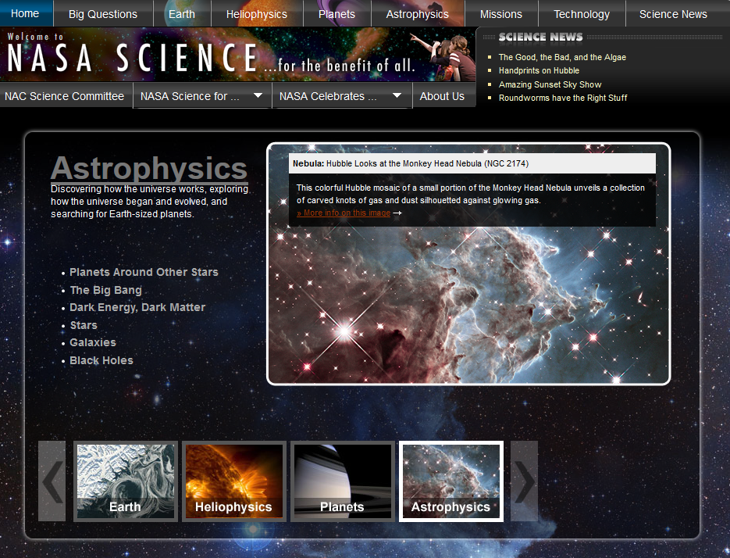
NASA’s Universe of Learning Astrophysics
Astrophysics STEM Learning & Literacy Network
Notes:
http://www.uwstout.edu/

Slide 2
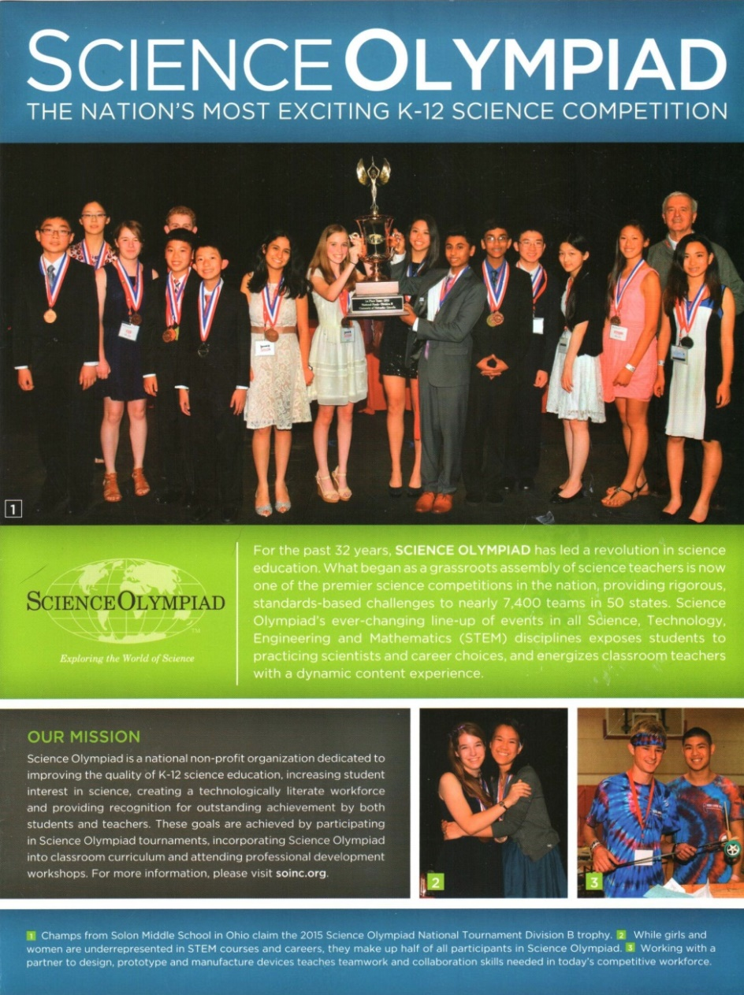
NASA’s Universe of Learning Astrophysics
NASA, Chandra X-Ray Center & National Science Olympiad Partnership
Donna L Young, NSO NASA STEM Outreach Coordinator
Notes:
http://www.uwstout.edu/

Slide 3
National Science Olympiad
32 Years
7,400 Teams
100,000 Students
400 Invitational, Regional, State & National Competitions
23 Events Each Division (B & C)
49 State Organizations
60 Teams Each Division at National Competition
(Florida, Nebraska, Wisconsin, Ohio, Colorado)
Notes:
http://www.uwstout.edu/

Slide 4
National Science Olympiad STEM materials and
events promote the content, science and engineering
practices, and cross-cutting concepts promoted by
the NGSS performance expectations.
Notes:
http://www.uwstout.edu/

Slide 5
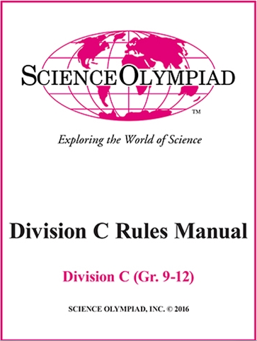
Ways you can contribute –
Event Supervisors – invitationals, regionals, states
Test Bank Questions & sample tests
Coaches Clinics & Team Mentors for content
Host Site for Regional or Invitational Competitions
Astronomy needs knowledgeable leaders; however, participation in any discipline or engineering event is appreciated!
Notes:
http://www.uwstout.edu/

